Slide 1

Flight Data Clustering Using EP-Means
Brandon Sams
05Mar2021

Slide 2
Overview
Understanding EP-Means
K-Means
Translation to EP-Means
Flight Dataset
Cleaning and Exploration
Implementing EP-Means
Earth Mover’s Distance
Cluster Centroid
Initial Clusters
Results

Slide 3
Understanding EP-Means

Slide 4
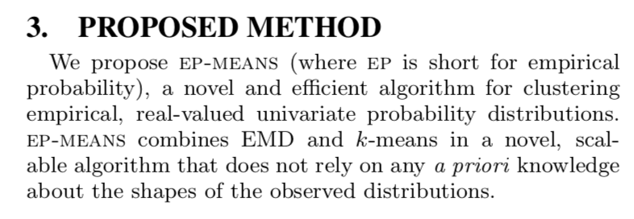
Understanding EP-Means
Henderson, K., Gallagher, B., & Eliassi-Rad, T. (2015). EP-MEANS: An efficient nonparametric clustering of empirical probability distributions. Proceedings of the 30th Annual ACM Symposium on Applied Computing, 893–900. https://doi.org/10.1145/2695664.2695860

Slide 5
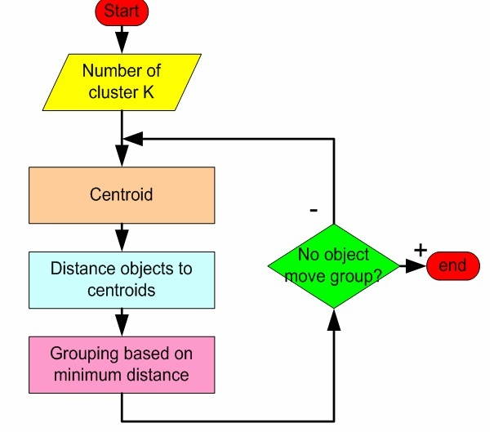
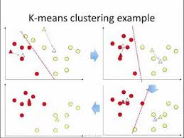
K-Means

Slide 6
K-Means
Relies on:
Distance
Centroid computation

Slide 7
Translation to EP-Means
Distance Metric:
Earth Mover’s Distance
Area Between Cumulative Distribution Functions

Slide 8
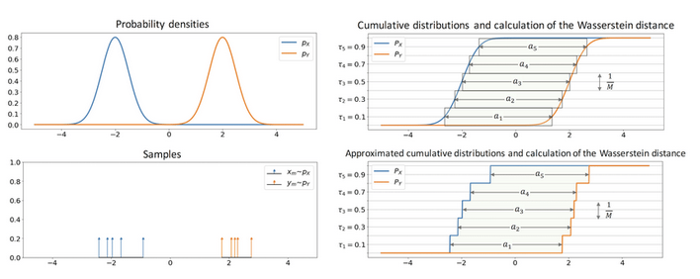
Earth Mover’s Distance

Slide 9
Translation to EP-Means
Centroid Computation:
Simple average of Probability Density Functions
PDF

Slide 10
Flight DataSet

Slide 11
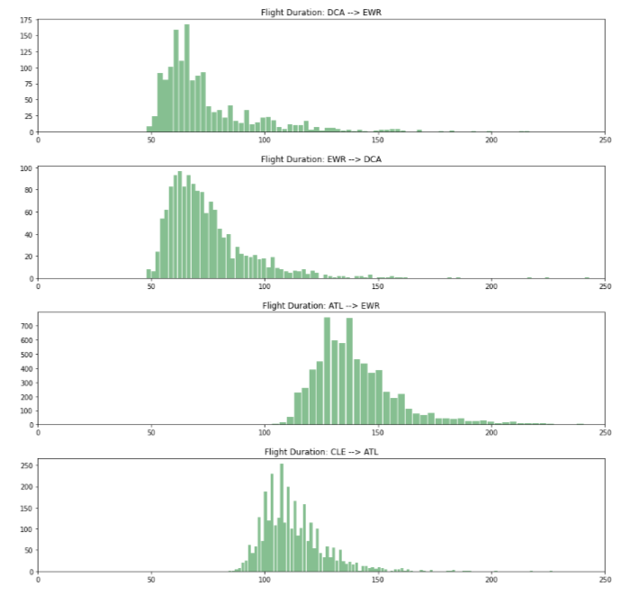
Flight Data
Flight Duration
Probability Distribution for each route
Bureau of Transportation
2009-2018 data

Slide 12
Flight Data Cleaning
Came as .csv files, one per year
Each row was a flight
Loaded them as 10 dataframes
Append dataframes together
Basic cleaning
Remove extra columns
Add a ROUTE column
Remove rows with missing data
Remove routes with less than 1000 flights
Save back to a .csv file

Slide 13
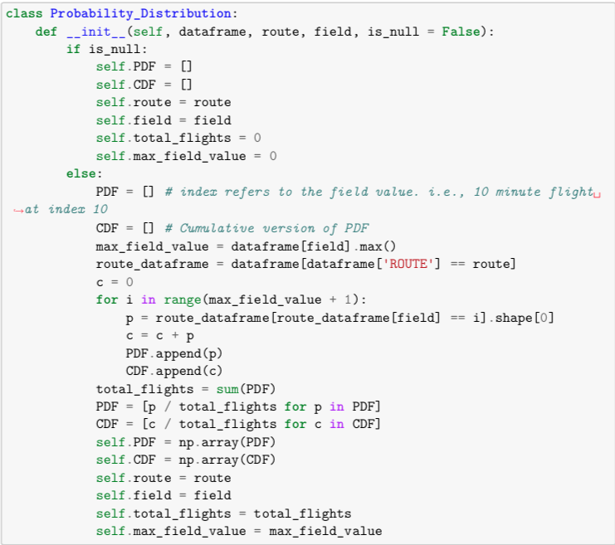
Constructing a Distribution
Given the large dataframe, make a distribution for each route
Created a Probability Distribution Class in Python
Each distribution has a PDF and a CDF

Slide 14
Implementing EP-Means with flight data

Slide 15
Implementing EP-Means
Wrote a function that can compute Earth Mover’s Distance for two distributions
Iterate through each possible flight duration
See how far apart the CDFs are at that point
Add to a running total
return the total
Runs very quickly

Slide 16
Implementing EP-Means
Wrote a function that can compute construct a centroid distribution for a collection of distributions fed in as input
Iterate through each possible flight duration
Find the average value of the PDF at that point
Add the average value to the resulting distribution’s PDF
Calculates the CDF as well
Return the centroid distribution
Runs slowly

Slide 17
Implementing EP-Means
Choosing Initial Clusters:
K-Means does not require initial clusters be chosen in any special way
Random choice is okay, but choosing poorly can lead to poor results
2 options:
Choose carefully (k-means++)
Run K-Means many times

Slide 18
K-Means++
Given all the data, compute the centroid. This is the first cluster center.
From the remaining data, using a weighted random choice, choose another point to be the next centroid
Weighted choice favors points which are far from any cluster centers
Repeat until K initial clusters have been defined

Slide 19
Results

Slide 20
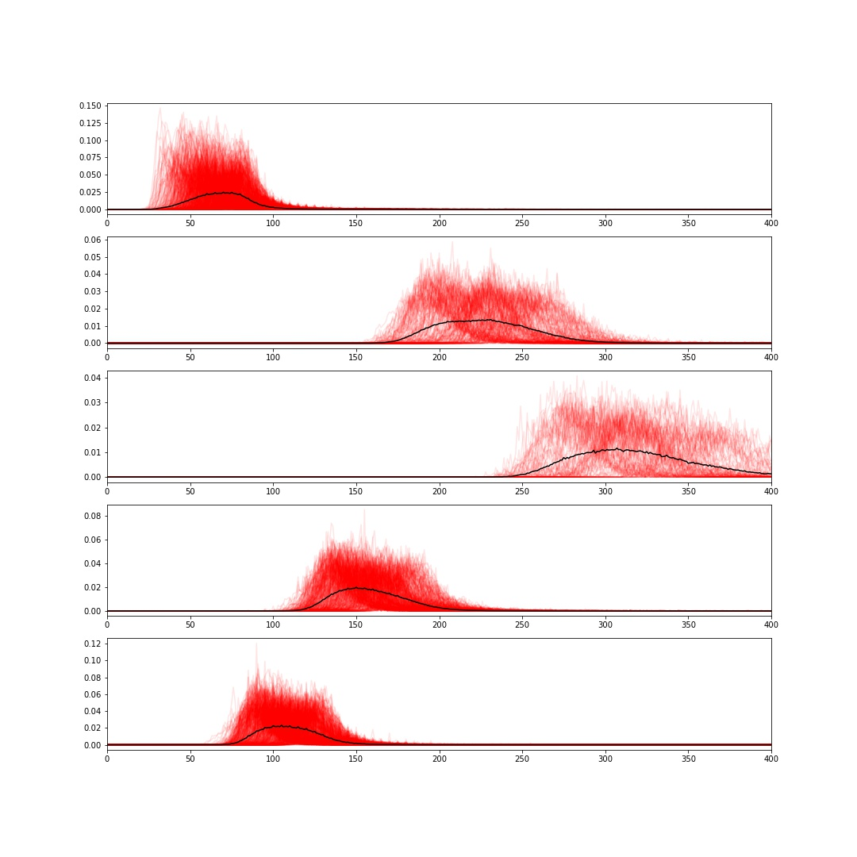
Results
Probability Density Functions
K = 5

Slide 21
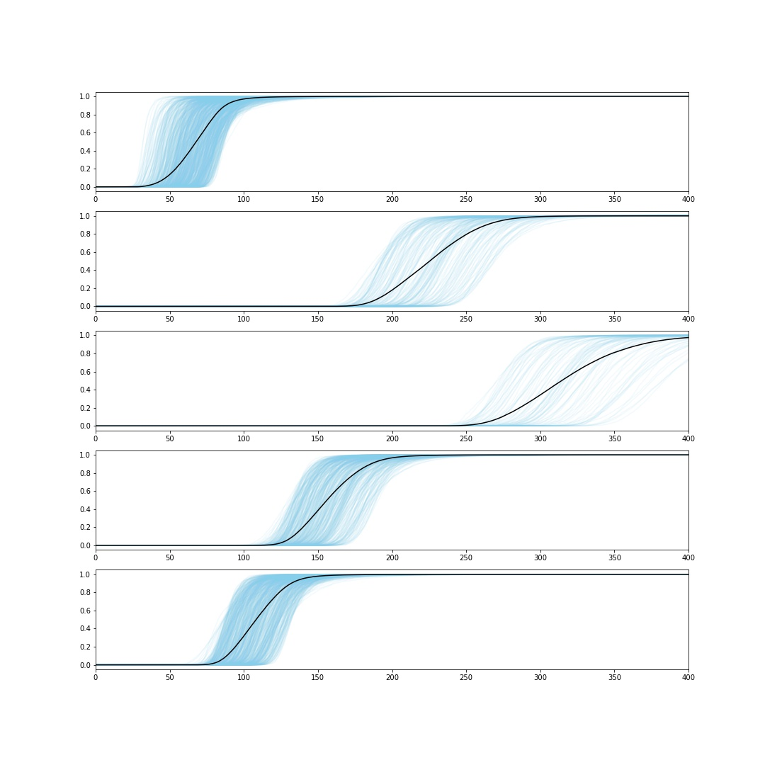
Results
Cumulative Distribution Functions
K = 5

Slide 22
Measuring Error
Error can be measured in total Earth Mover’s Distance between each distribution and its respective cluster centroid

Slide 23
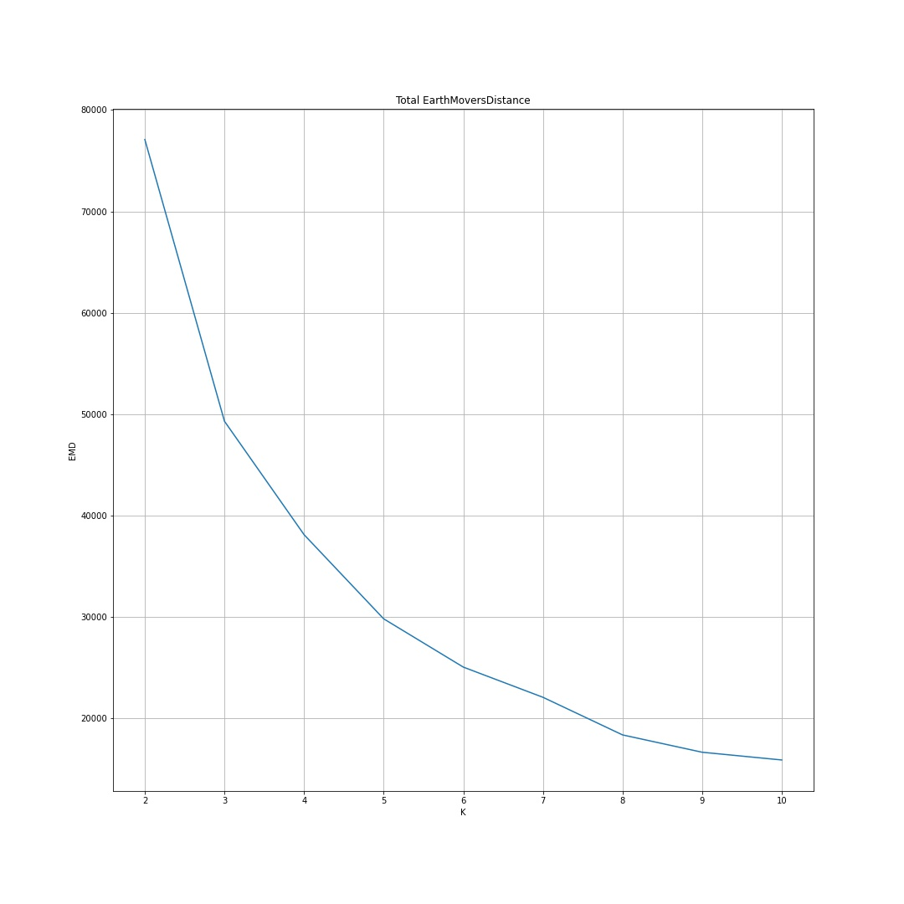
Other Values of K
Clustering was run for values of K between 2 and 10
Expected that error would drop as K increased
K=5 appears to be the ”Elbow Point”
Past K=5, the error doesn’t drop near as fast

Slide 24
Review
Understanding EP-Means
K-Means
Translation to EP-Means
Flight Dataset
Cleaning and Exploration
Implementing EP-Means
Earth Mover’s Distance
Cluster Centroid
Initial Clusters
Results

Slide 25
Conclusion
EP-Means:
Benefits:
Very fast
Can be optimized by choosing initial clusters carefully
Does not assume the distributions to be in a certain shape
Drawbacks:
Very specific use case
Flight routes can be clustered in accordance with the distribution of their durations

